Slide 1
Innovative Approaches for Green Energy Optimization in Smart Cities Using Artificial Intelligence
By Osagiede John Osemwengie and Vimeth Jayawardana

Slide 2
INTRODUCTION
Urban Evolution:
Cities have evolved into dynamic ecosystems where technology intertwines with our daily lives. The rise of smart cities marks a transformative era, where connectivity and data converge to enhance urban living.
Transformative Impact:
Advancements in technology have redefined the urban landscape, introducing a spectrum of possibilities for efficiency, sustainability, and citizen well-being. Smart cities leverage innovation to tackle complex challenges and create seamless, intelligent environments.
Green Energy Optimization:
At the heart of urban transformation lies the imperative to optimize energy usage. This presentation delves into the innovative use of Artificial Intelligence (AI) to elevate sustainability, reduce carbon emissions, and enhance energy efficiency in smart cities.

Slide 3
“Initial Foundation were Laid by Albawi and Voulodimos”
For Insightful Energy Analysis Using AI
Albawi and Vouladimos play crucial roles in the application of AI for energy optimization, with Albawi focusing on algorithmic development and data analysis, while Vouladimos concentrates on the infrastructure and deployment aspects. Their collaboration results in a powerful and effective solution for optimizing energy usage.

Slide 4
Machine Learning in Energy Prediction
Let's get started!

Slide 5
Machine Learning in Energy Prediction
Approach:
Building upon this foundation, our project employs advanced machine learning algorithms for insightful energy consumption analysis.
Predictive Modeling for Future Demands:
We leverage predictive modeling to forecast future energy demands. Parameters include weather conditions, population density, and urban activities.
Machine Learning for Sustainable Cities:
Our focus is on harnessing AI algorithms to not only analyze historical energy patterns but also predict and optimize future energy needs, contributing to sustainable and eco-friendly urban environments.

Slide 6

Proposed Methodology

Slide 7
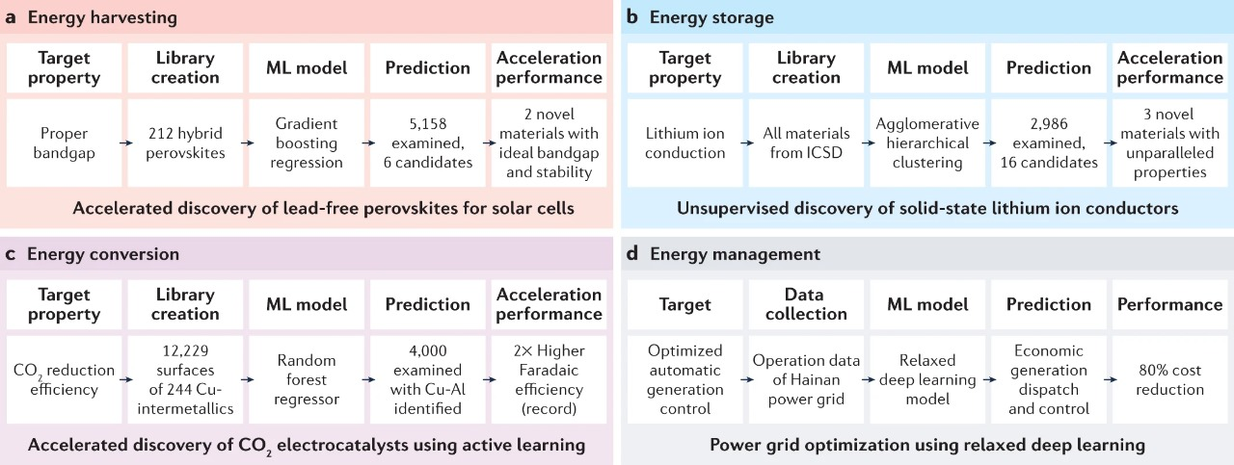
Proposed Methodology
Our proposed method focuses on the integration of AI techniques into smart city infrastructure for the purpose of optimizing green energy consumption. The key components of our approach include:
A. AI-Driven Energy Consumption Analysis
B. Dynamic Energy Distribution
C. Optimized energy storage
D. Demand side management

Slide 8
A. AI-Driven Energy Consumption Analysis
Implementing sophisticated machine learning algorithms, our
approach analyzes historical energy consumption patterns in
smart cities. By utilizing predictive modeling, we forecast future
energy demands, considering parameters such as weather
conditions, population density, and urban activities. The output is
a trained Random Forest (RF) model, capable of accurately
predicting energy consumption based on given features.

Slide 9
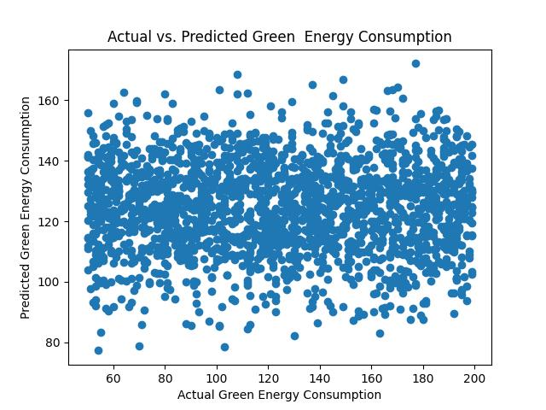
Plots analysis:
Model Evaluation: Assessing the performance of the machine learning model (Random Forest Regressor) in predicting green energy consumption for a smart city. Utilizes Mean Squared Error (MSE) and Mean Absolute Error (MAE) as metrics for model accuracy.
Error Analysis: Identifying potential discrepancies in the model's predictions based on the calculated MSE and MAE. Providing insights into the accuracy and reliability of the model in predicting energy consumption.
Visual Comparison: Visualizing the scatter plot of actual vs. predicted green energy consumption. Aiding in the interpretation of how well the model captures the patterns and trends in energy consumption.

Slide 10
B. Dynamic Energy Distribution
Our approach involves crafting an adaptive energy distribution system
that capitalizes on real-time data and AI algorithms for precise allocation
of energy resources. By implementing reinforcement learning techniques,
we optimize energy distribution networks, minimizing waste and
maximizing the utilization of renewable energy sources.

Slide 11
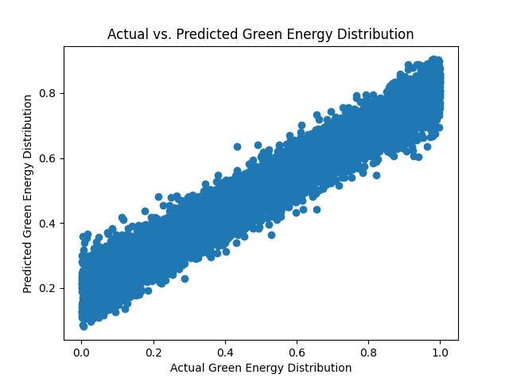
Plots analysis:
Optimizing Energy Distribution: Evaluating the efficiency of the adaptive energy distribution system in dynamically allocating energy resources in real-time.
Leveraging MSE and MAE metrics to gauge the accuracy of predictions during dynamic distribution scenarios.
Reinforcement Learning Impact: Assessing the effectiveness of reinforcement learning techniques in adapting the energy distribution system to varying demands.
Visualizing the actual vs. predicted green energy distribution to understand how well the system responds to dynamic changes.

Slide 12
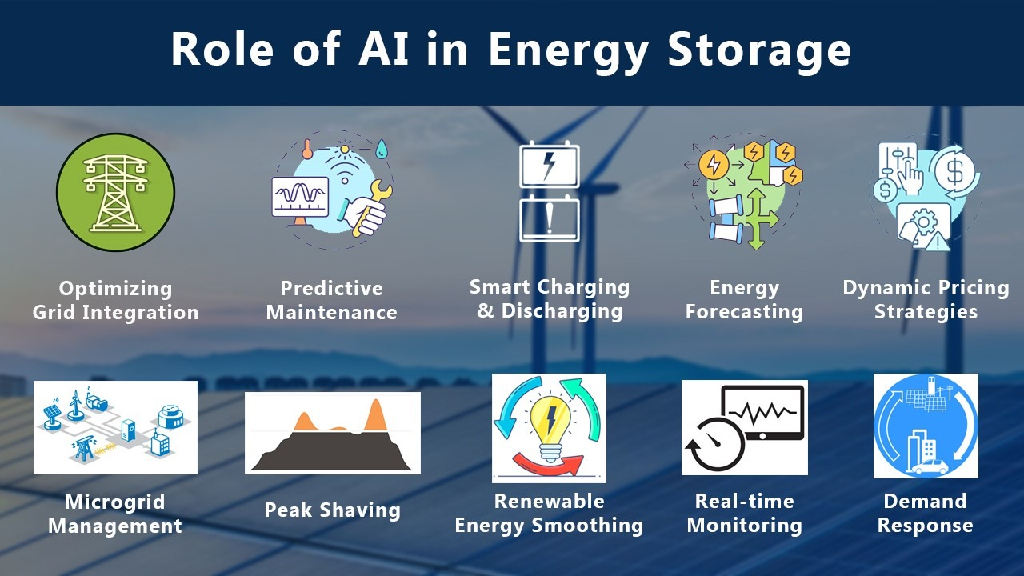
C. Optimized Energy Storage
Our strategy involves integrating AI
algorithms to enable predictive
maintenance and optimization of
energy storage systems, including
batteries and capacitors. Machine
learning models are deployed to
assess the health of the energy
storage infrastructure, allowing for
proactive scheduling of
maintenance activities.

Slide 13
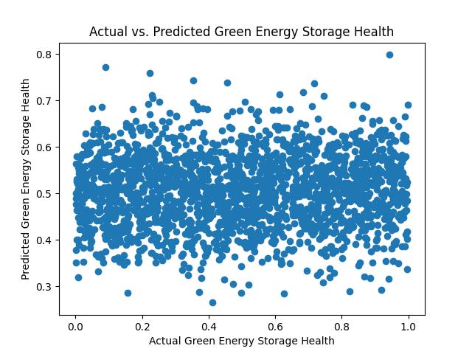
Plots analysis:
Energy Storage Health Evaluation: Analyzing the health of energy storage systems (e.g., batteries, capacitors) in a smart city.
Utilizing machine learning models to predict and assess the health of energy storage infrastructure.
Proactive Maintenance Planning: Offering insights into the proactive scheduling of maintenance activities for energy storage systems based on predictive models.
Assessing the accuracy of predictions through MSE and MAE metrics.
Visualizing Predictions: Visual representation of actual vs. predicted green energy storage health, aiding in the interpretation of model performance.

Slide 14
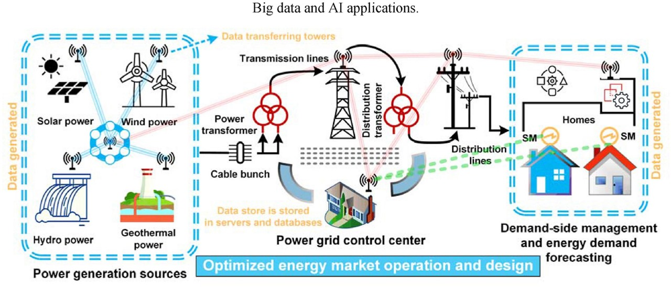
D. Demand-Side Management:
Our approach integrates AI-based
demand-response systems to
actively engage with end-users,
fostering energy-efficient
practices. Through the
implementation of smart grid
technologies, we dynamically
adjust energy consumption in real-
time, effectively minimizing overall
energy usage, especially during
peak periods.

Slide 15
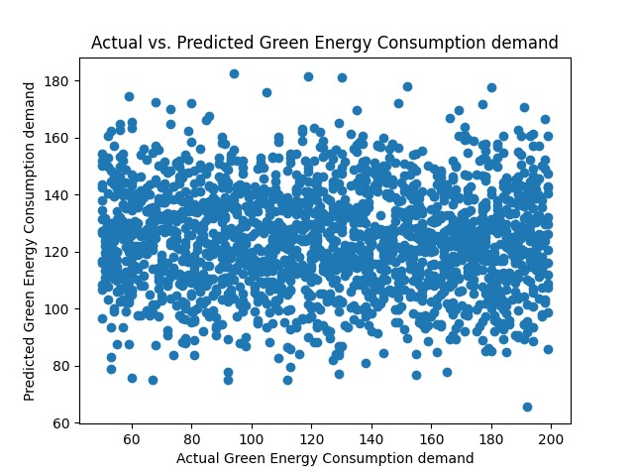
Plots analysis:
Energy Consumption Prediction in Demand-Side Management: Assessing the model's capability to predict green energy consumption in demand-side management scenarios.
Utilizing MSE and MAE metrics to gauge the accuracy of predictions.
Understanding Demand Response Impact: Analyzing the impact of demand response systems on energy consumption patterns.
Visualizing the scatter plot of actual vs. predicted energy consumption demand in demand-side management scenarios.

Slide 16
Model Evaluation Metrics
Evaluating the Success of Our AI-Driven Model

Slide 17
Essentials for AI model test accuracy
Mean Squared Error (MSE):
(Minimizing prediction errors)
MSE measures the average squared difference between actual and predicted values. It's a common regression metric; lower MSE values indicate more accurate predictions.
Accuracy Score:
(Assessing overall correctness)
Accuracy calculates the ratio of correctly predicted instances to the total instances. It's a straightforward metric for classification problems, but it can be influenced by imbalanced datasets.

Slide 18
Essentials for AI model test accuracy
Precision and Recall:
(Balancing false positives and false negatives)
Measures the accuracy of positive predictions. It's the ratio of true positives to the sum of true positives and false positives.
F1 Score:
(Harmonizing precision and recall)
F1 Score is the harmonic mean of precision and recall. It provides a balanced evaluation, especially useful when there is an uneven class distribution.
ROC-AUC:
(Assessing model's ability to distinguish between classes)
ROC-AUC evaluates the trade-off between true positive rate (sensitivity) and false positive rate. A higher AUC suggests a better ability to distinguish between classes.

Slide 19

DEMO TIME

Slide 20
Future plans and enhancements
The following future plans highlight a strategic focus on advanced AI integration, real-time adaptability, user engagement, cybersecurity, and usability—key aspects that contribute to the ongoing success and sustainability of the green energy optimization project in smart cities.
1. Integration of Advanced AI Models
2. Real-Time Data Integration
3. Enhanced Demand-Side Management Strategies
4. Cybersecurity Measures
5. User-Friendly Interfaces for Stakeholders
6. Multi-Objective Optimization
7. Incorporation of External Factors
8. Continuous Monitoring and Feedback Loop

Slide 21
Conclusion
In summary, our project on 'Innovative Approaches for Green Energy Optimization in Smart Cities Using Artificial Intelligence' has been a comprehensive exploration into cutting-edge solutions for urban sustainability. We delved into detailed energy consumption analysis, dynamic distribution strategies, optimized energy storage, and demand-side management, employing a Python codebase to implement and evaluate each fact.
The future plans outlined a strategic vision, emphasizing the integration of advanced AI models, real-time data adaptability, user-centric demand-side strategies, robust cybersecurity measures, and user-friendly interfaces. This roadmap positions our project at the forefront of sustainable urban development.
From addressing current challenges to laying down a roadmap for the future, the project encapsulates a forward-thinking approach to green energy optimization. Through meticulous research, Python implementation, and future-proofing strategies, our project is not just a study but a blueprint for a smarter and greener future for smart cities.

Slide 22

THANKS!
Any questions?
You can email us at:
oosemwengie1@student.gsu.edu kjayawardana1@student.gsu.edu

